Slide 1
NIPS 2016 Tutorial: Generative Adversarial Networks
I. Goodfellow. (2016). NIPS 2016 tutorial: Generative adversarial networks, Proc. Neural Information Processing Systems Conf. [Online]. Available: https://arxiv.org/abs/1701.00160
2025-02-11
Sein Choi
Intelligent Vision Processing Lab. (IVPL)
https://ivpl.sookmyung.ac.kr
Div. of AI Engineering, Sookmyung Women’s University
E-mail: csi1806@sookmyung.ac.kr

Slide 2
Contents
V(D,G) : Objective function
Find D*(x) – maximize V(D,G)
Find D*(x) – minimize J^D (cost function)
Unrolled GAN

Slide 3
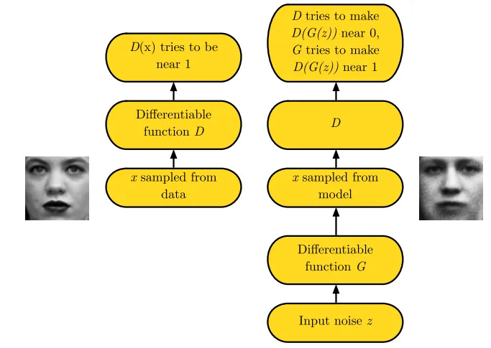

How do GANs work?
The Nash equilibrium of this game: a tuple
Local minimum of J(D) with respect to θ(D)
Local minimum of J(G) with respect to θ(G)

Slide 4
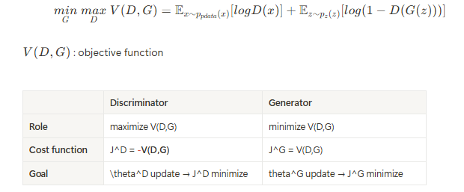
V(D,G) : Objective function
Adversarial modeling framework

Slide 5
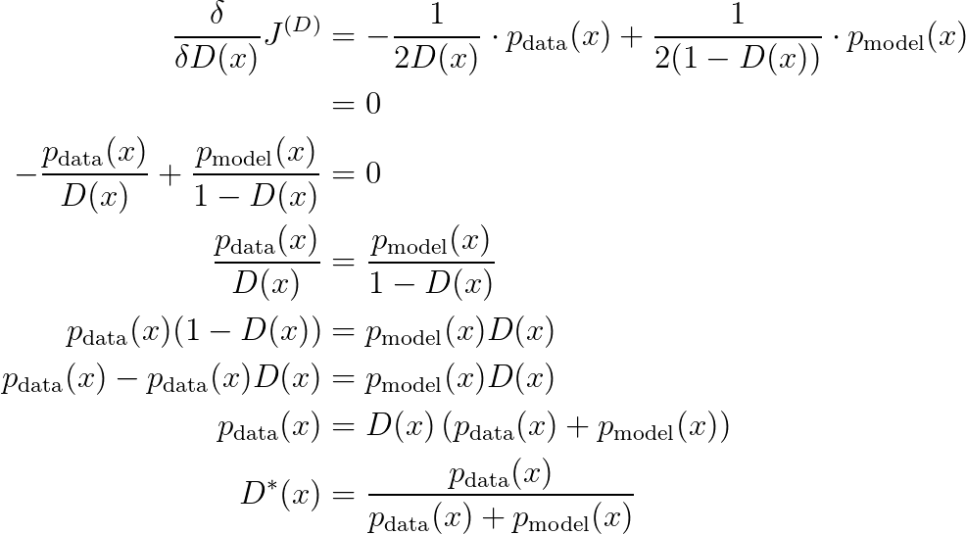

GANs can simulate many cost functions
| Discriminator’s cost
By training the discriminator, it is possible to estimate the ratio for all points x using the equation below.
As a result, supervised learning is performed to estimate this ratio.
GAN framework = GANs 'adversarial'.
Notes:
discriminator의 목표는 \theta^{(D)}에 대하여 이 식을 최소화
Discriminator가 functional space에서 최적화될 수 있는데, 이를 증명해보고자 함.
실제 CNN에서는 weight 간 얽혀 있기 때문에 완벽한 최적화는 어렵
가정: p_data와 p_model은 어디서나 nonzero.
이게 성립하지 않으면, 몇몇 point들은 학습 중 never visited, 그리고 undefined behavior가짐
다시 돌아와서 우리의 목적인 J(D)를 minimize하려면 D(x)에 대하여 functional derivatives(함수적 도함수) 쓰고 0으로 설정하면 됨.
D(x)에 대해 미분 시 0 되도록
그래서 증명하면 최적의 D(x) 찾을 수 있음
이렇게 D를 학습하면, 모든 x에 대해 data/model의 식; 그러니까 두 분포의 비율을 추정 가능. 이 비율을 통해 supervised learning

Slide 6
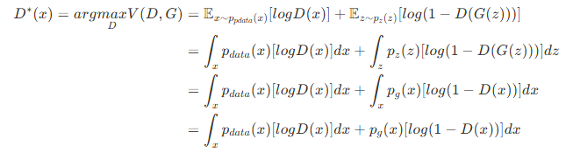
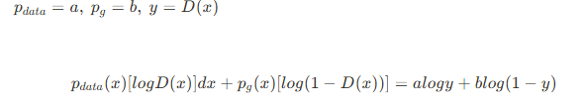
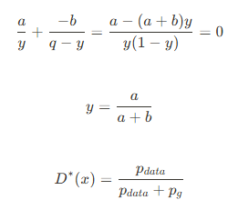
Find D*(x) – maximize V(D,G) (objective function)
sampling x from p_g instead of sampling z from p_z
z->G(z)->x->D(x)
To find the optimal D∗(x) that maximizes V(D,G), we need to differentiate V(D,G) and find D(x) such that it equals zero

Slide 7


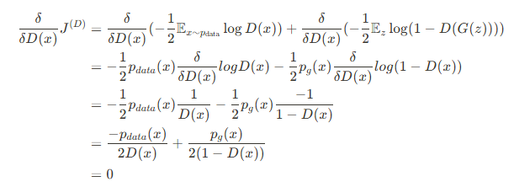
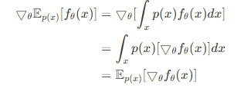

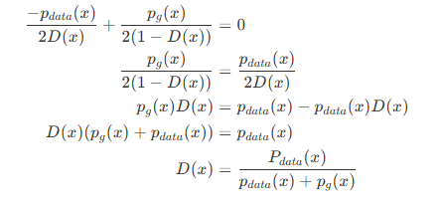

Find D*(x) – minimize J^D (cost function)

Slide 8
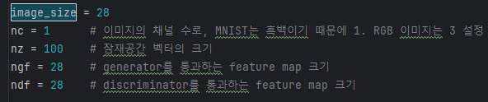
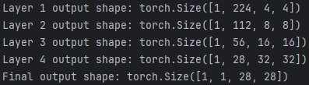
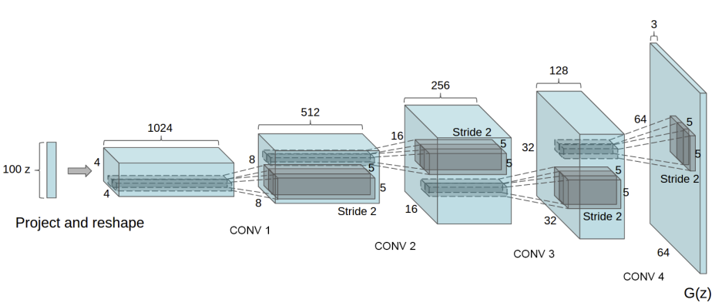
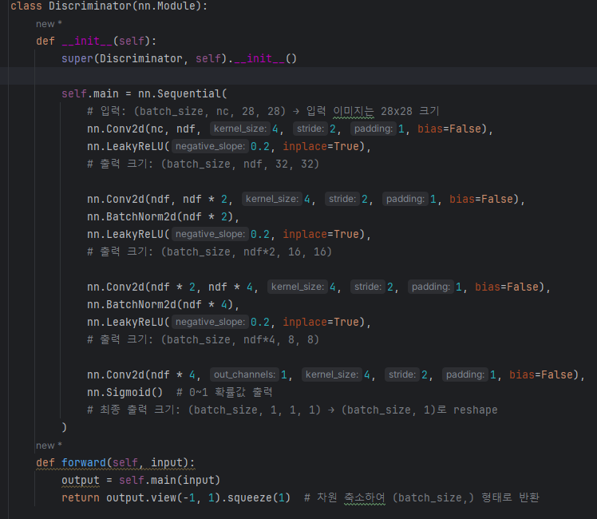
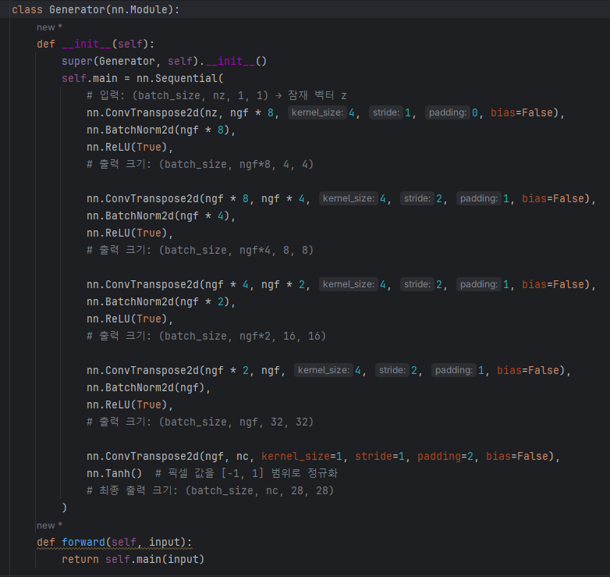
Code Implementation - DCGAN
1
1
56
28
224(28*8)
112
28
28

Slide 9

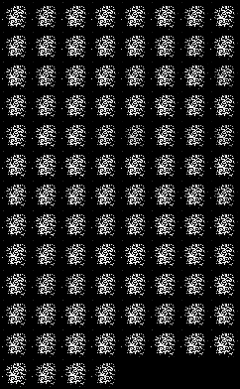
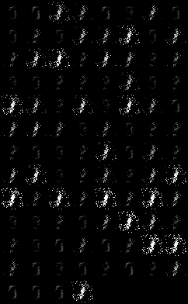
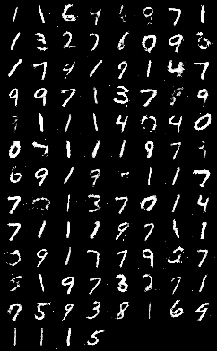
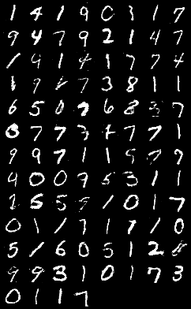
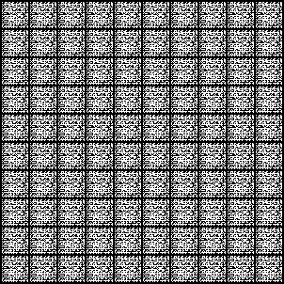
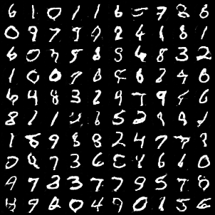
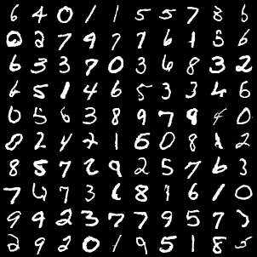
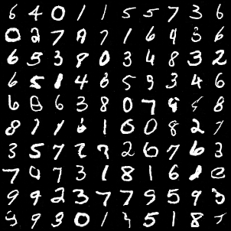
Generating Fake NMIST Image
VAE 10 epochs
1 epochs
10 epochs
100 epochs
200 epochs
GAN
DCGAN

Slide 10
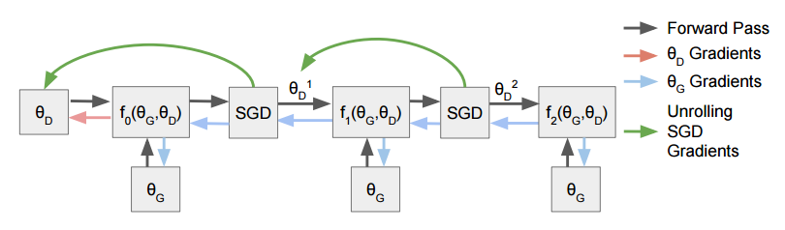




Unrolled GAN
https://youtu.be/2FYHYzFx80g?si=9q3DF-N4_Hs55pK3
Goal
parameter update
effect on the generator learning
Error: Local optimum, gradient computation time
is unreachable. Let’s approximate learning
optimal discriminator D*(x)
Unroll GAN
Original GAN
Simulate updating D k times

Slide 11
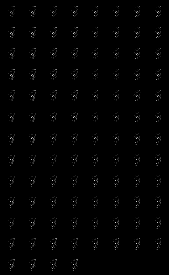
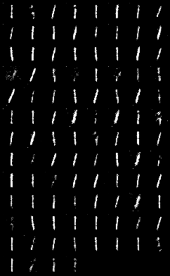
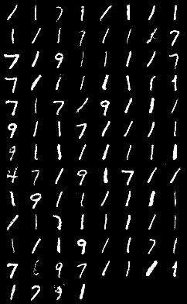
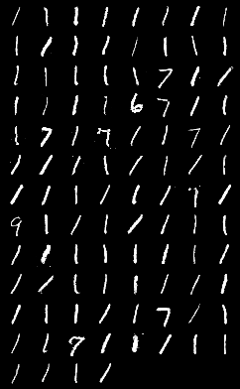
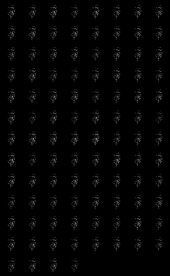
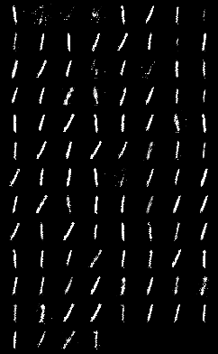
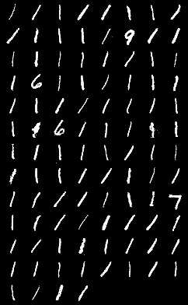
Generating Fake NMIST Image
1 epochs
10 epochs
100 epochs
200 epochs
GAN k_step
k=3
Unrolled
GAN
3steps

Slide 12
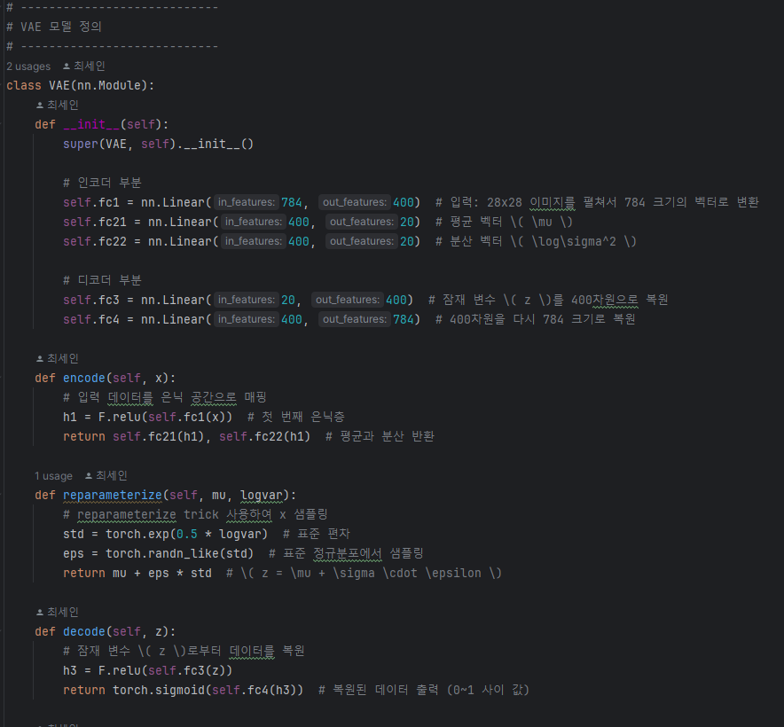
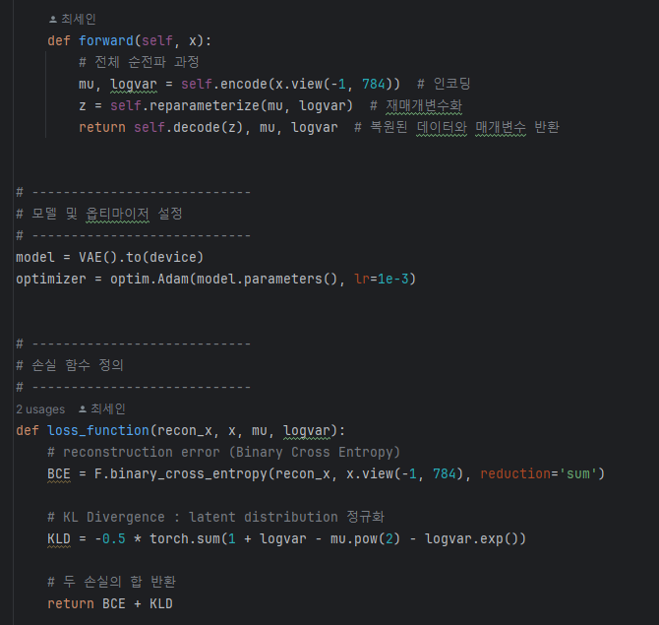
VAE code

Slide 13
Thank you for your attention.!!!
QnA

